Slide 1

Mahindra First Choice Services
Presented by :
Omkar Asukar
Durgesh Kumar
Mandar Vast
Durvesh Tambe

Slide 2
Business Problem
Geolocation Based Analysis:
Extract insights regarding the ownership pattern of cars based on location features of the customers.
Find out how the different type of services and service time vary with location.
Analyse the revenue generated at different locations throughout the country
Market Segmentation:
Divide the customer base into different segments based on the activeness, number of visits to garage, service type and revenue generated .
This will help to better understand the customer behavioural patterns and have targeted marketing campaigns and rewards based on the segments
Customer Lifetime Value Prediction:
Predict the value given by the customer over his lifetime based on the average spend over a year and number of visits.
Analysing CLV would help Mahindra First Choice focus on the customers who are going to generate good value to the company.

Slide 3

Exploratory Data Analysis
Lets Start with the first steps of Visualizations

Slide 4
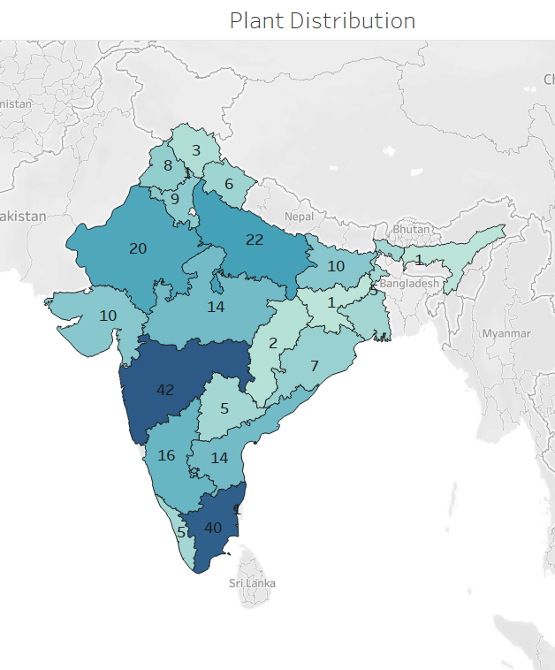
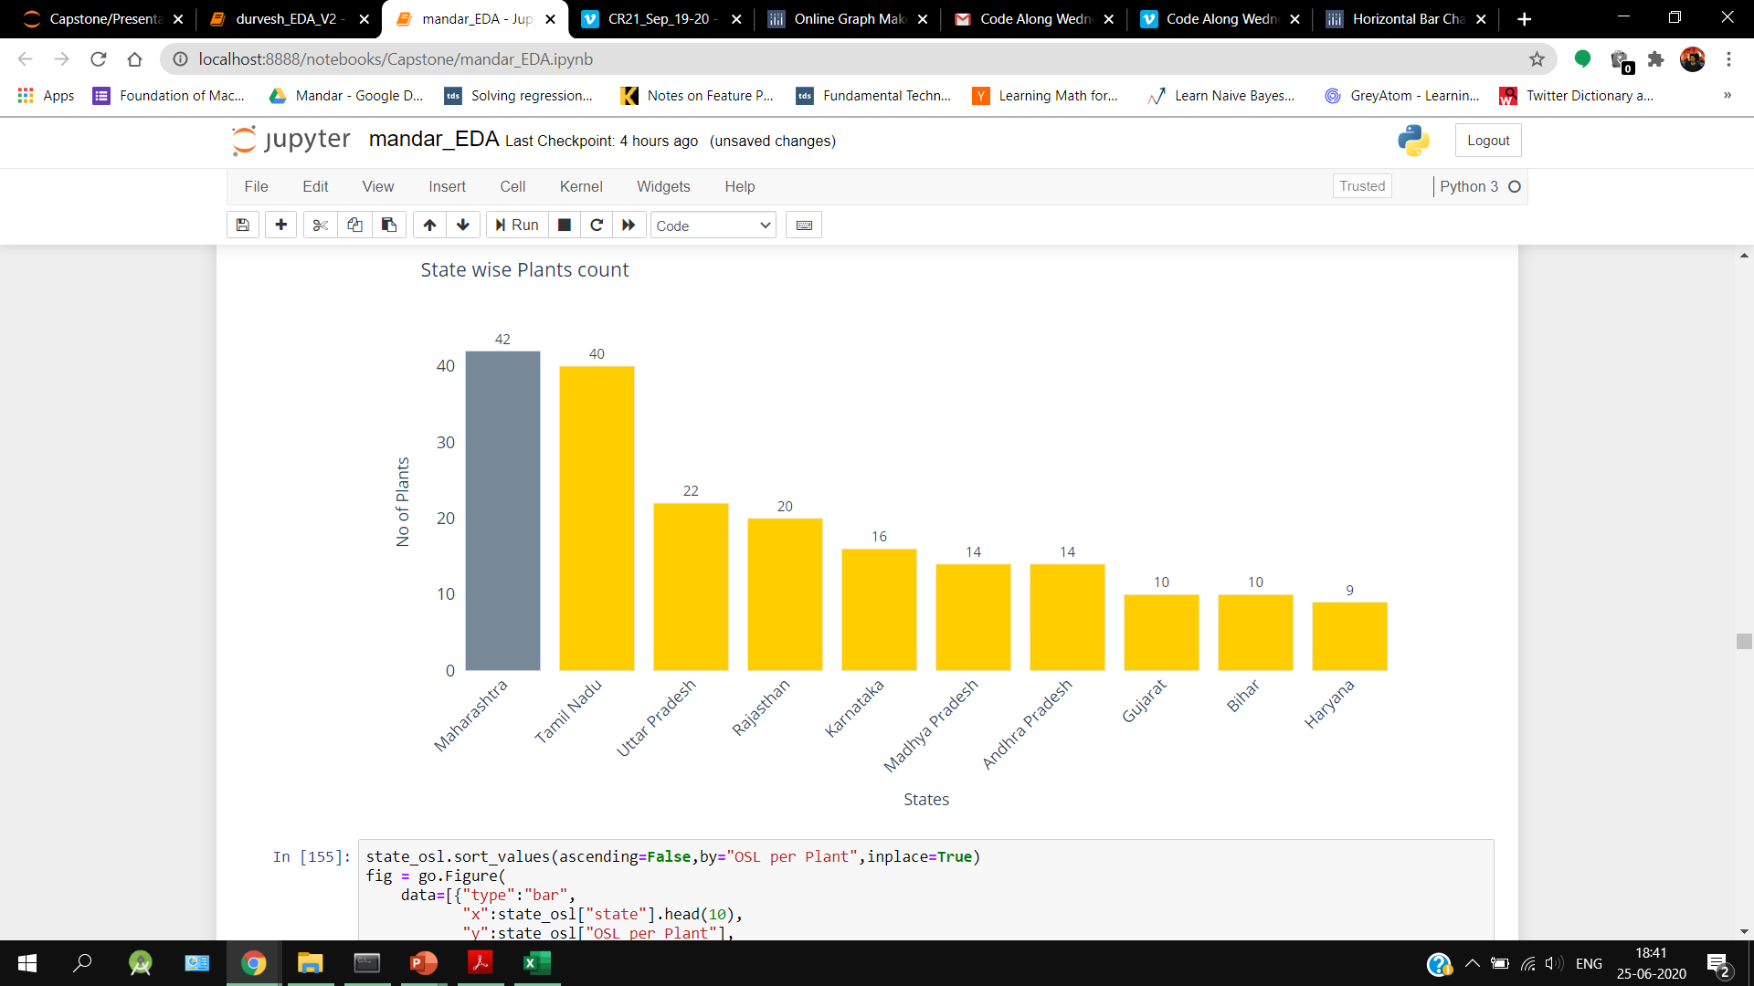
Plant Distribution

Slide 5
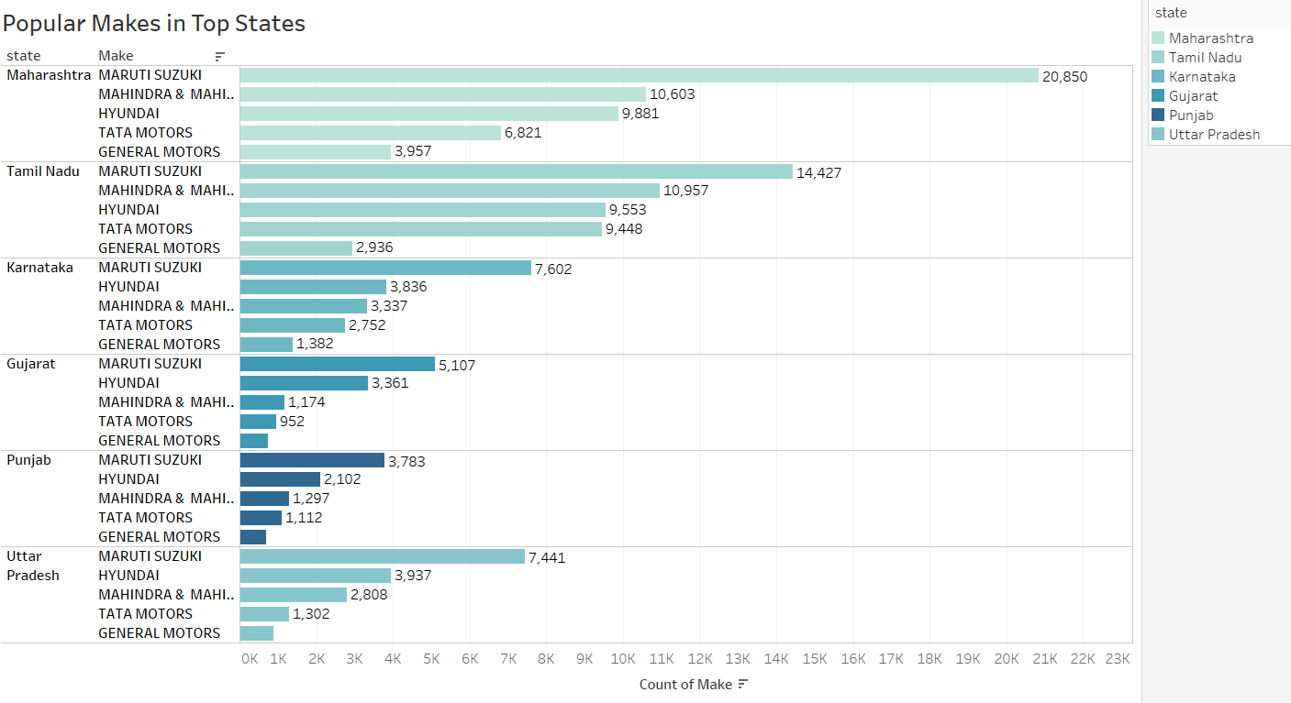
Popular Make in Top States

Slide 6
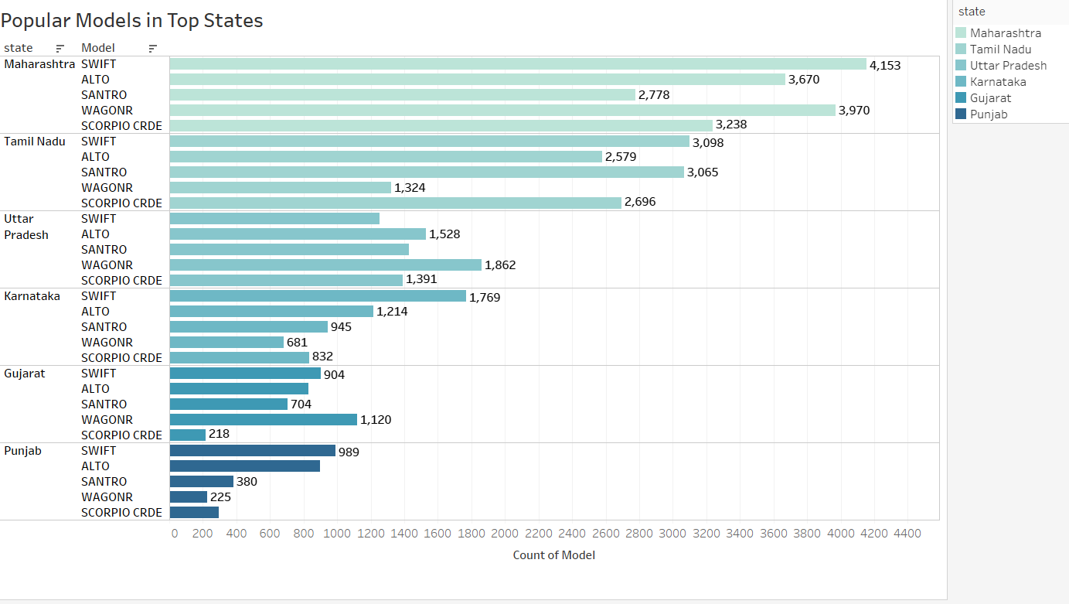
Popular Models in Top States

Slide 7
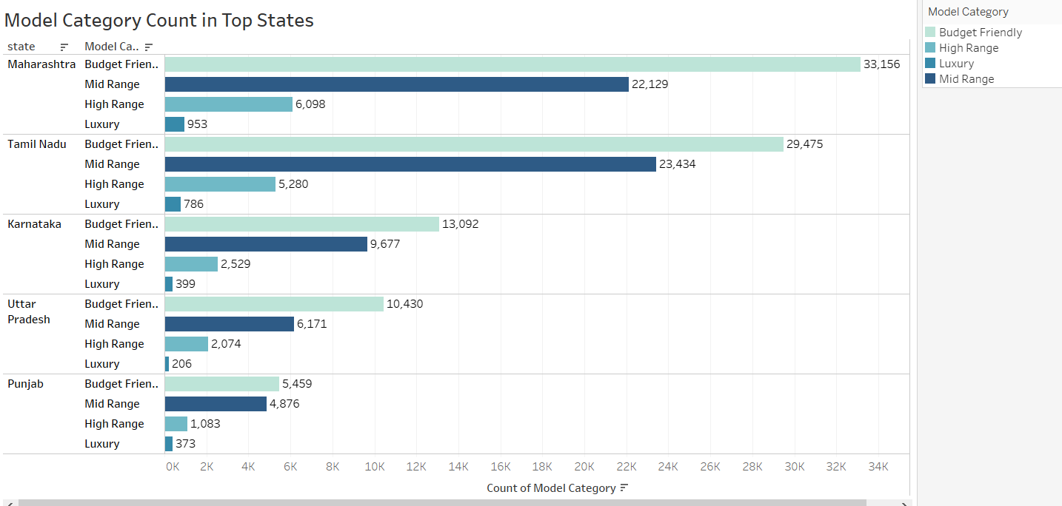
Model Category Count in Top States

Slide 8
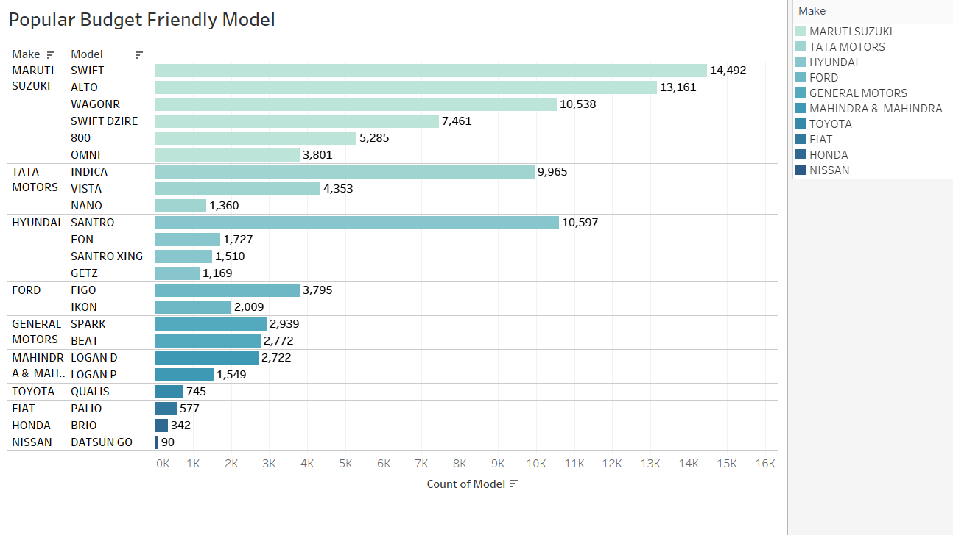
Popular Budget Friendly Car Models

Slide 9
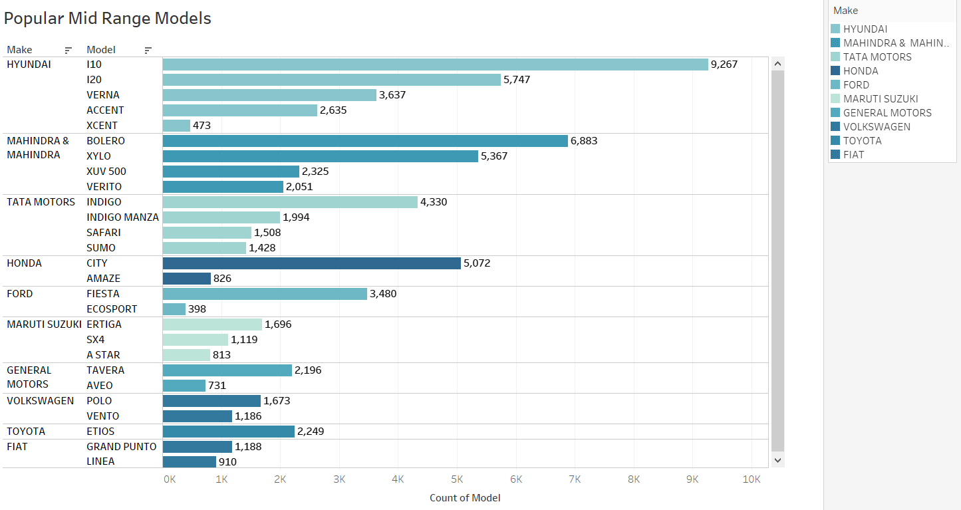
Popular Mid Range Car Models

Slide 10
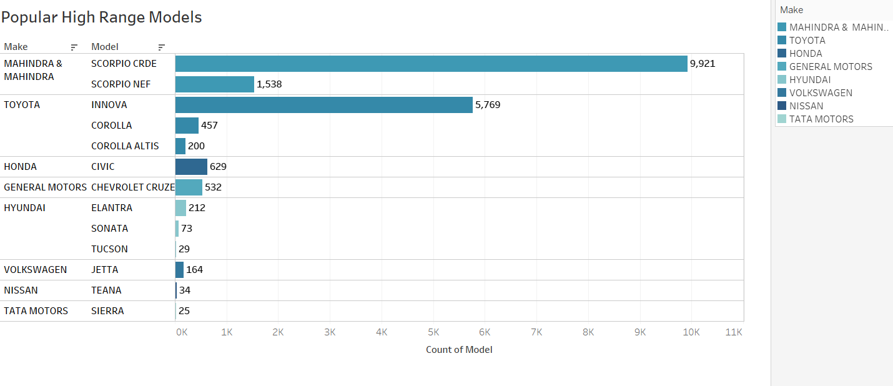
Popular High Range Car Models

Slide 11
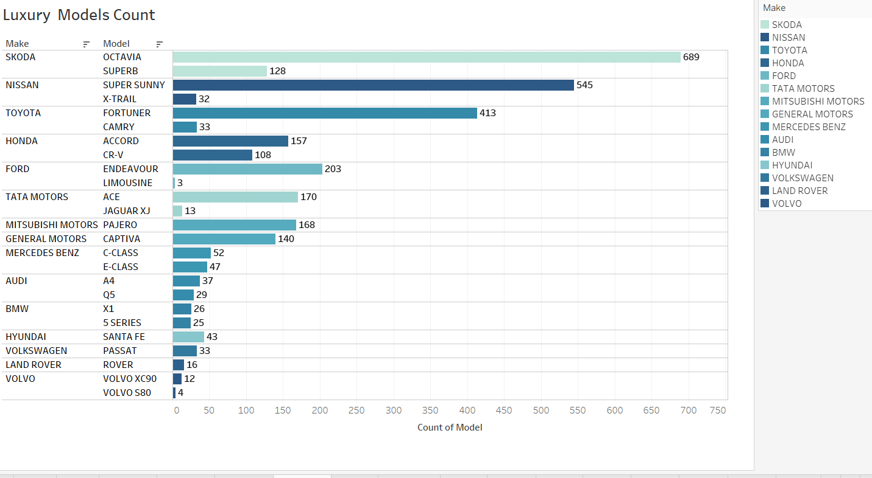
Popular Luxury Models

Slide 12
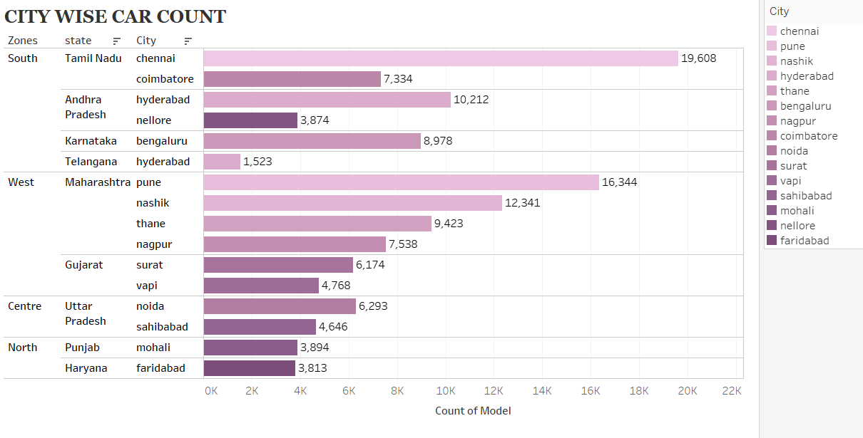
City Wise Car Count

Slide 13
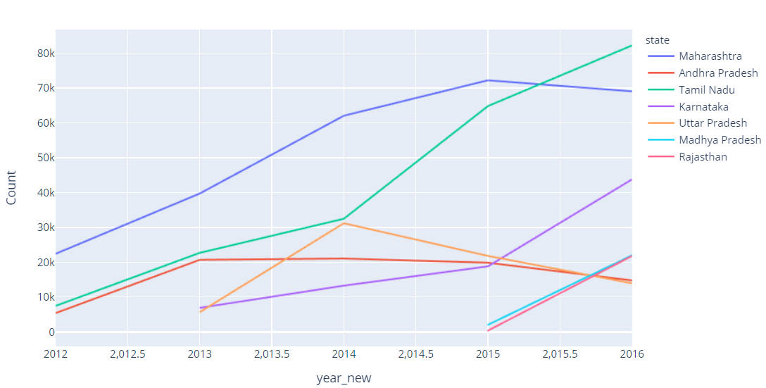
State wise Invoice count

Slide 14
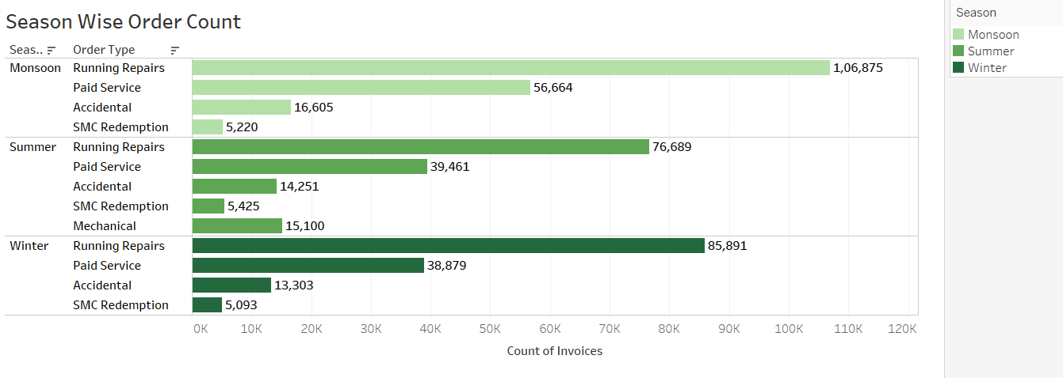
Season wise Order Distribution

Slide 15
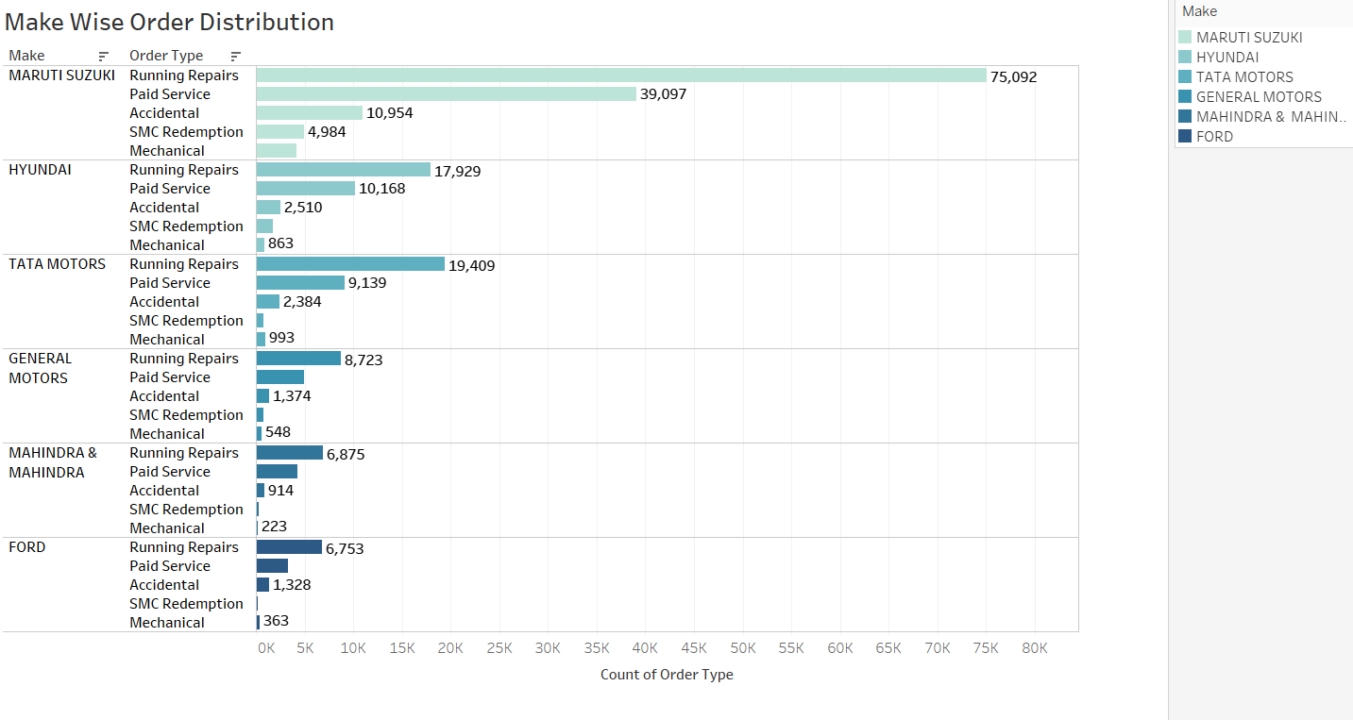
Make wise Order Distribution

Slide 16
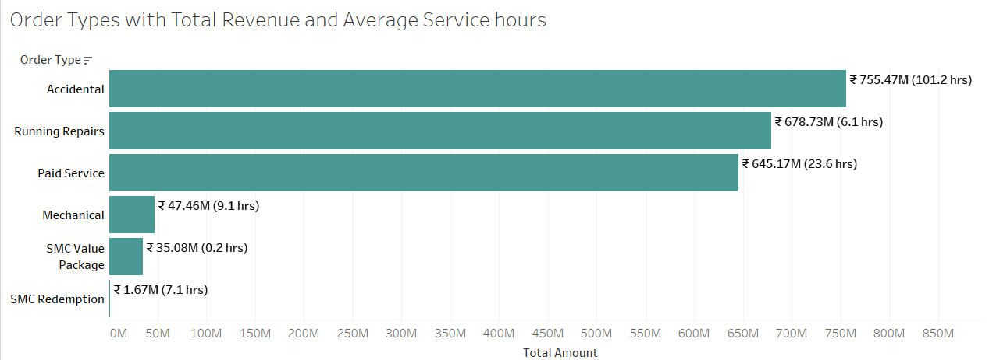
Order Type with Total Revenue and Service Hours

Slide 17
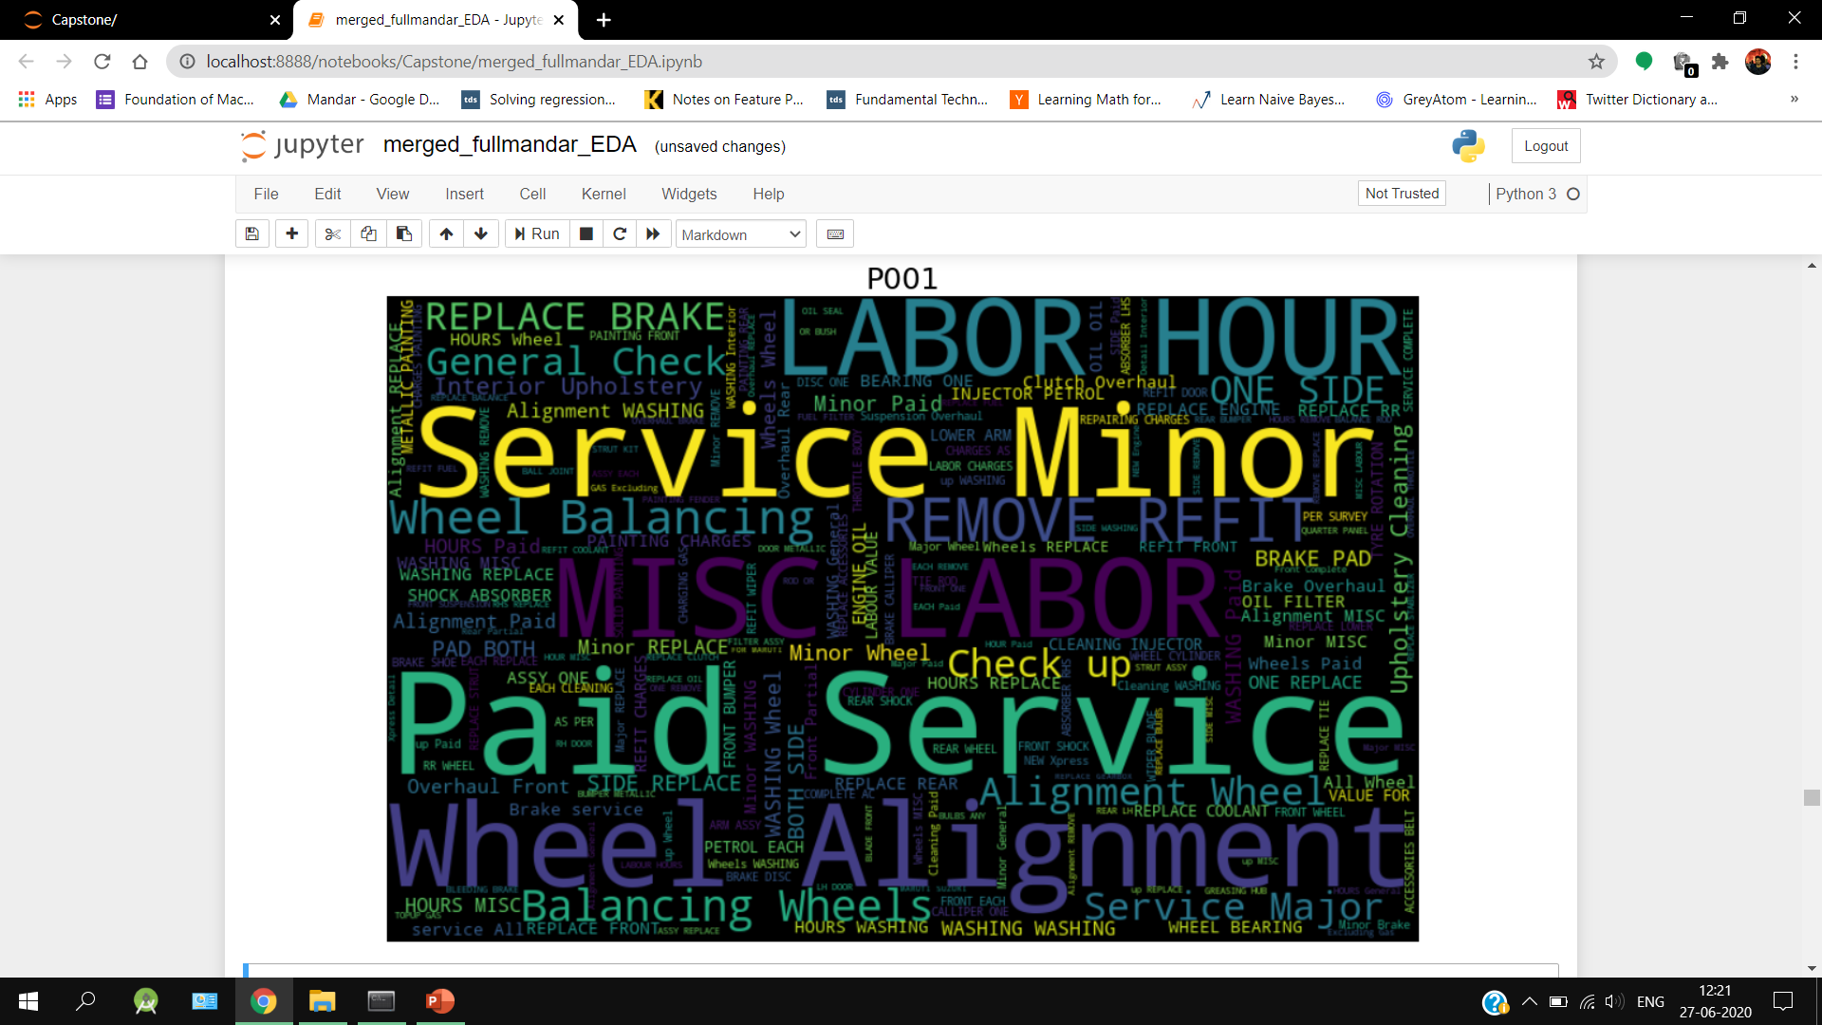
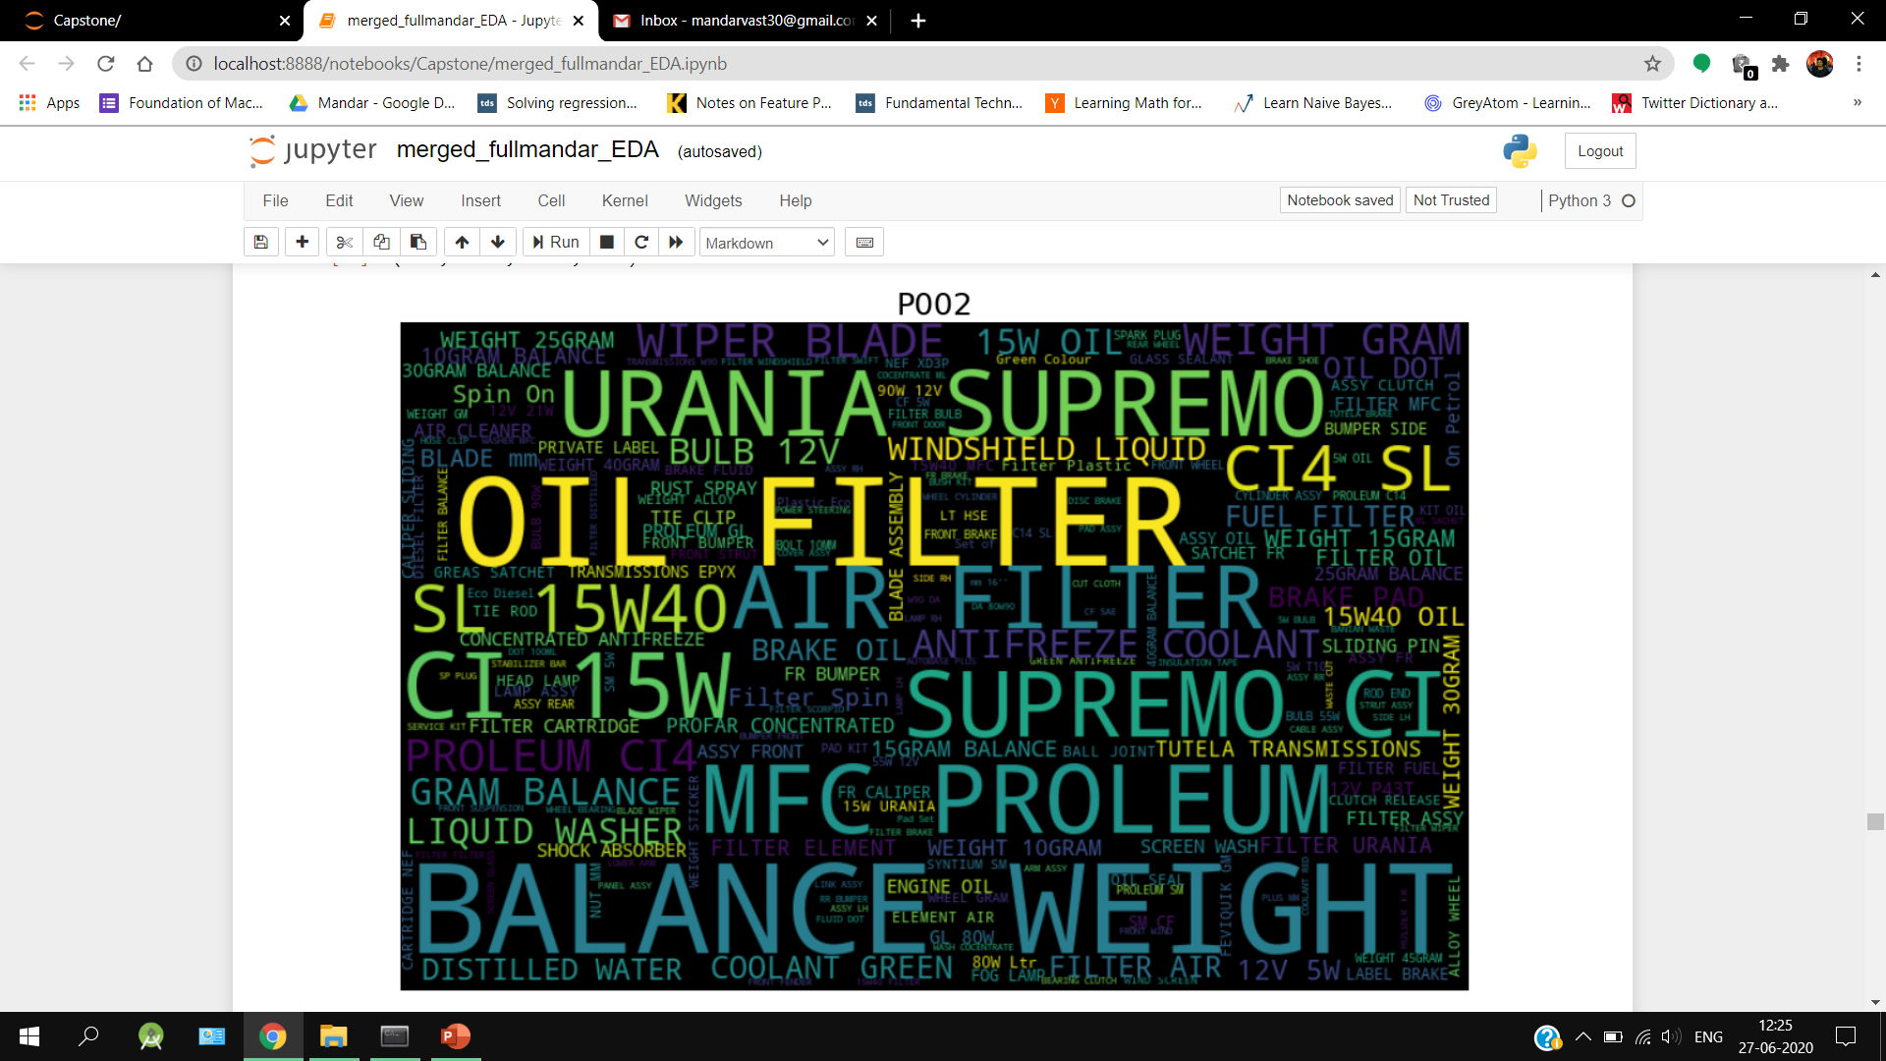
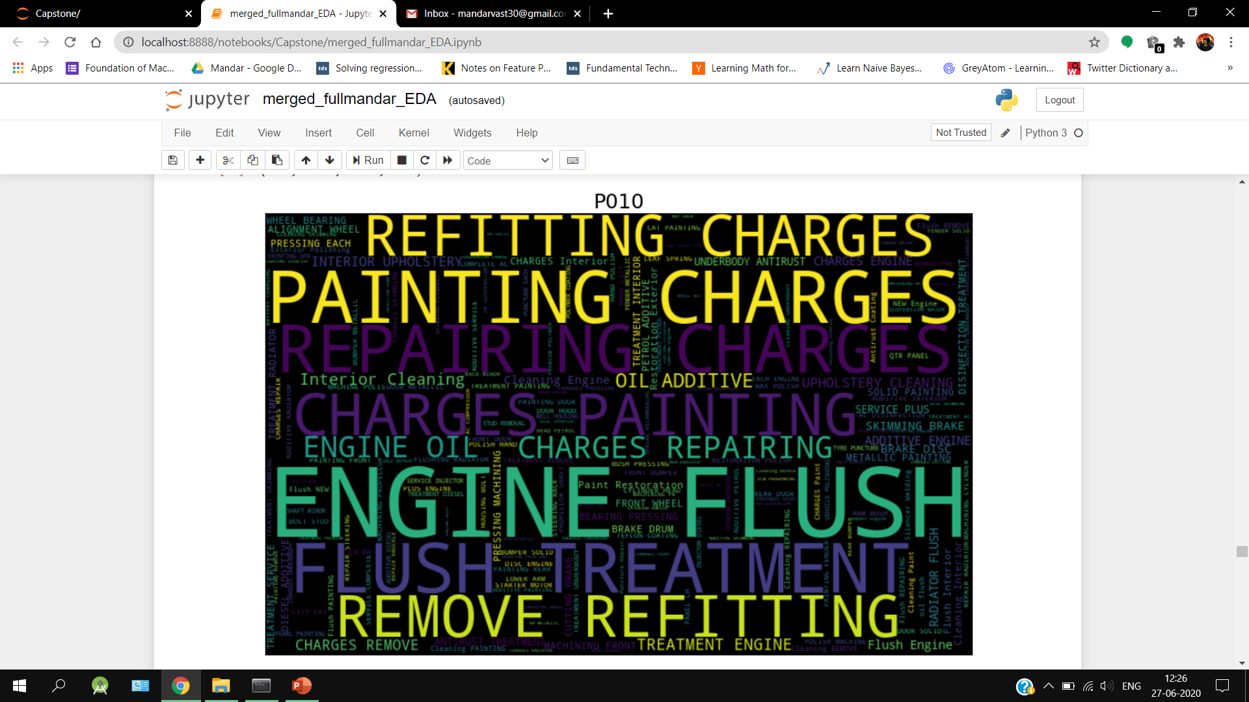
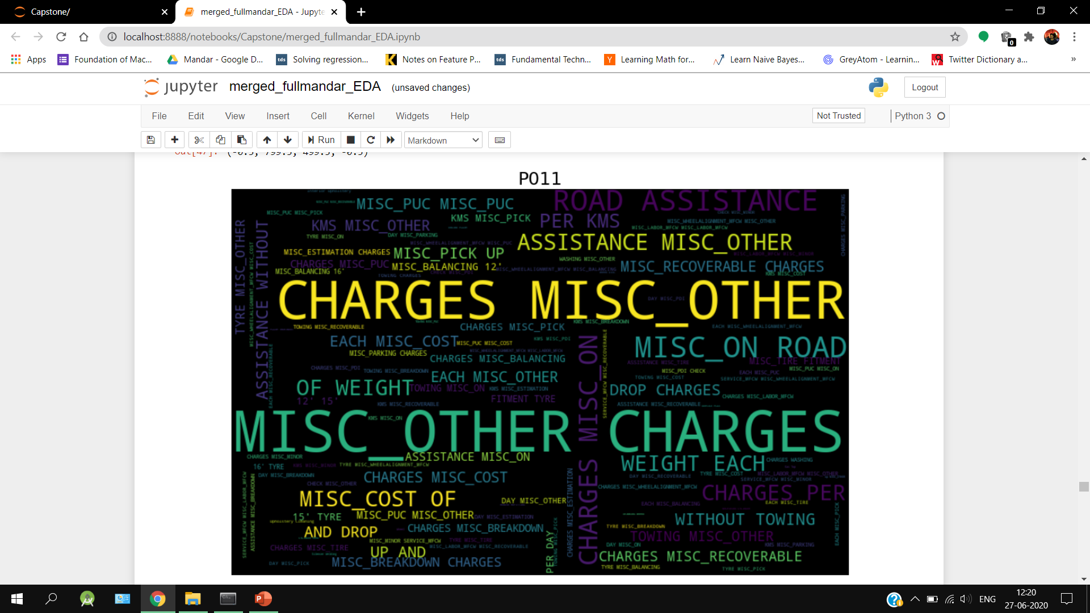
Word Cloud for Item Category Description

Slide 18
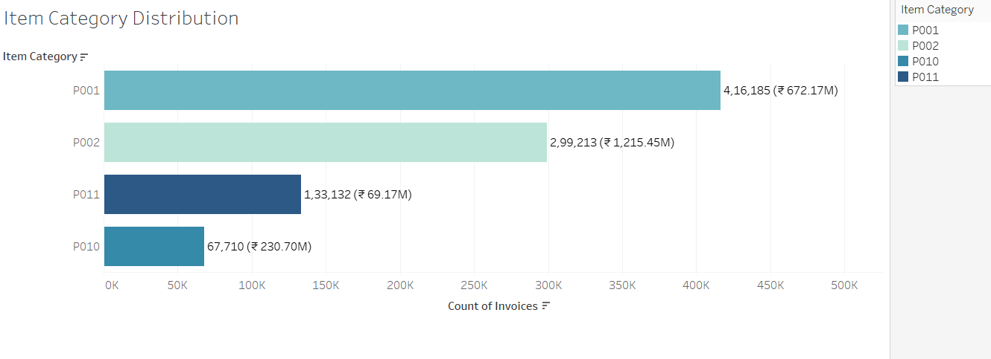
Distribution of Item Category

Slide 19
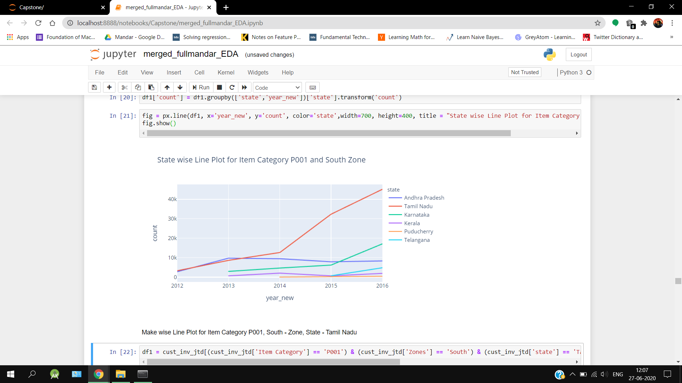
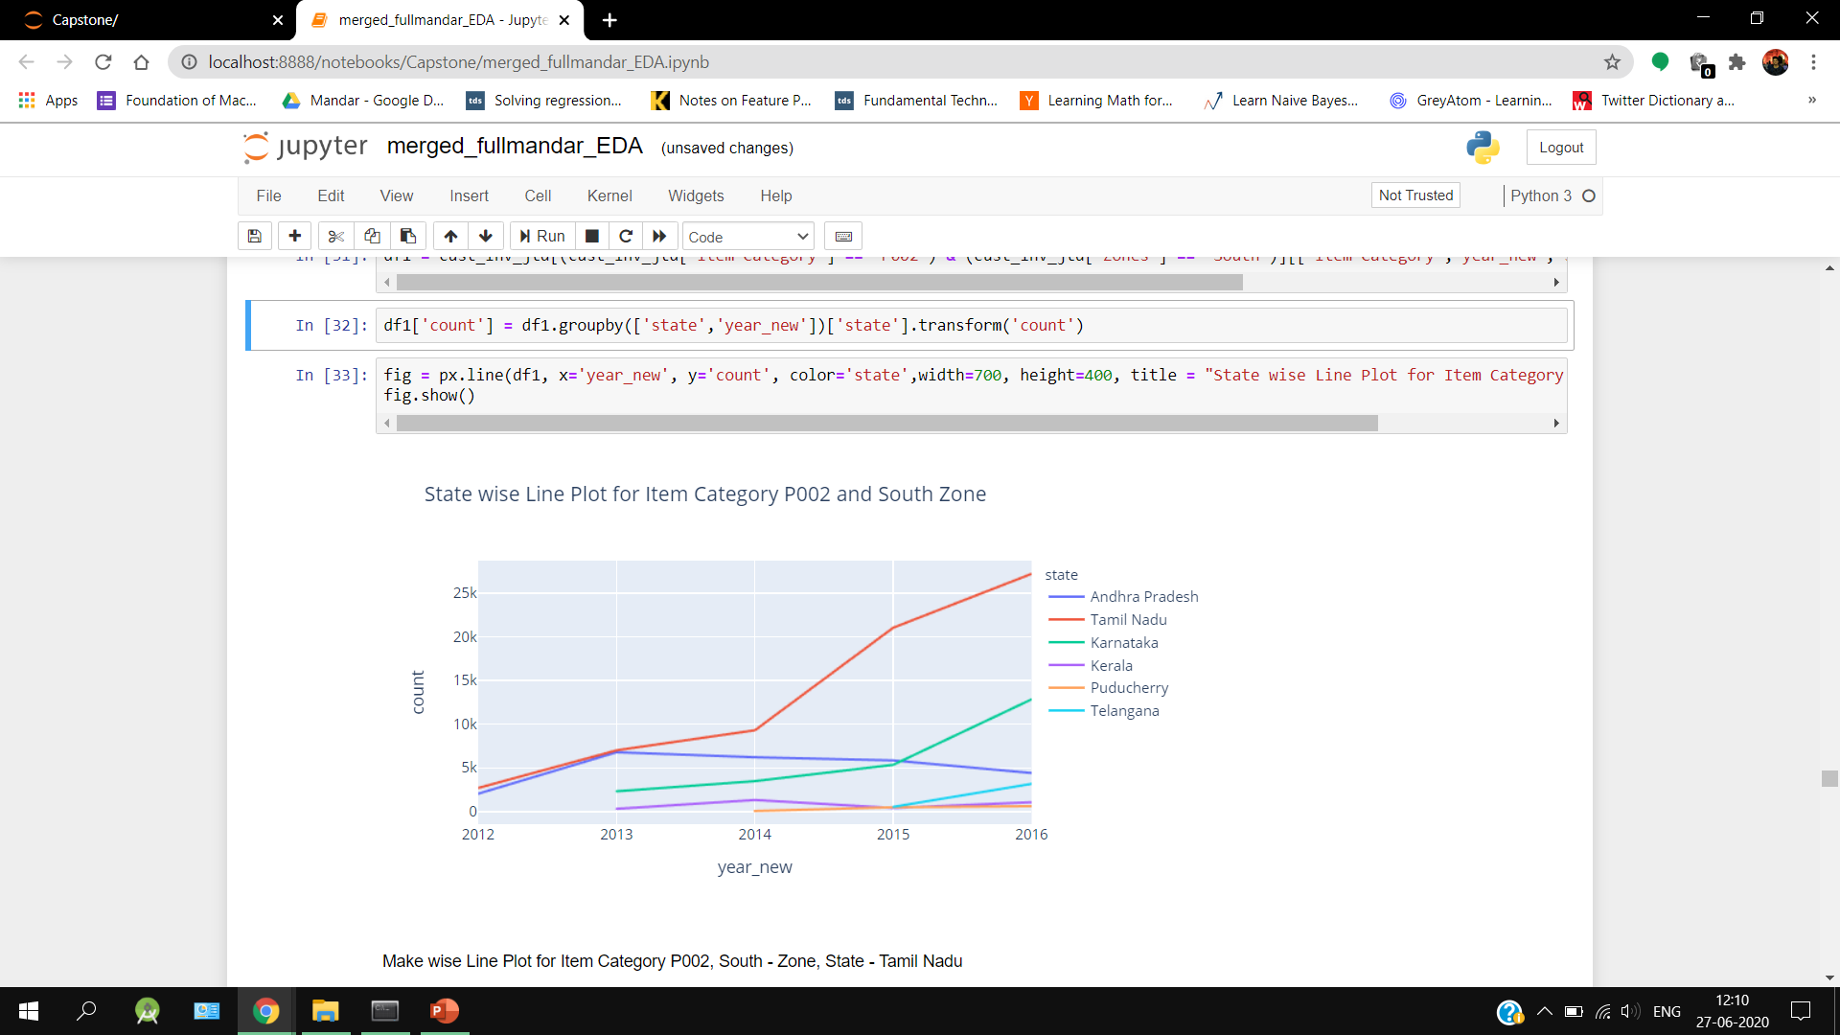
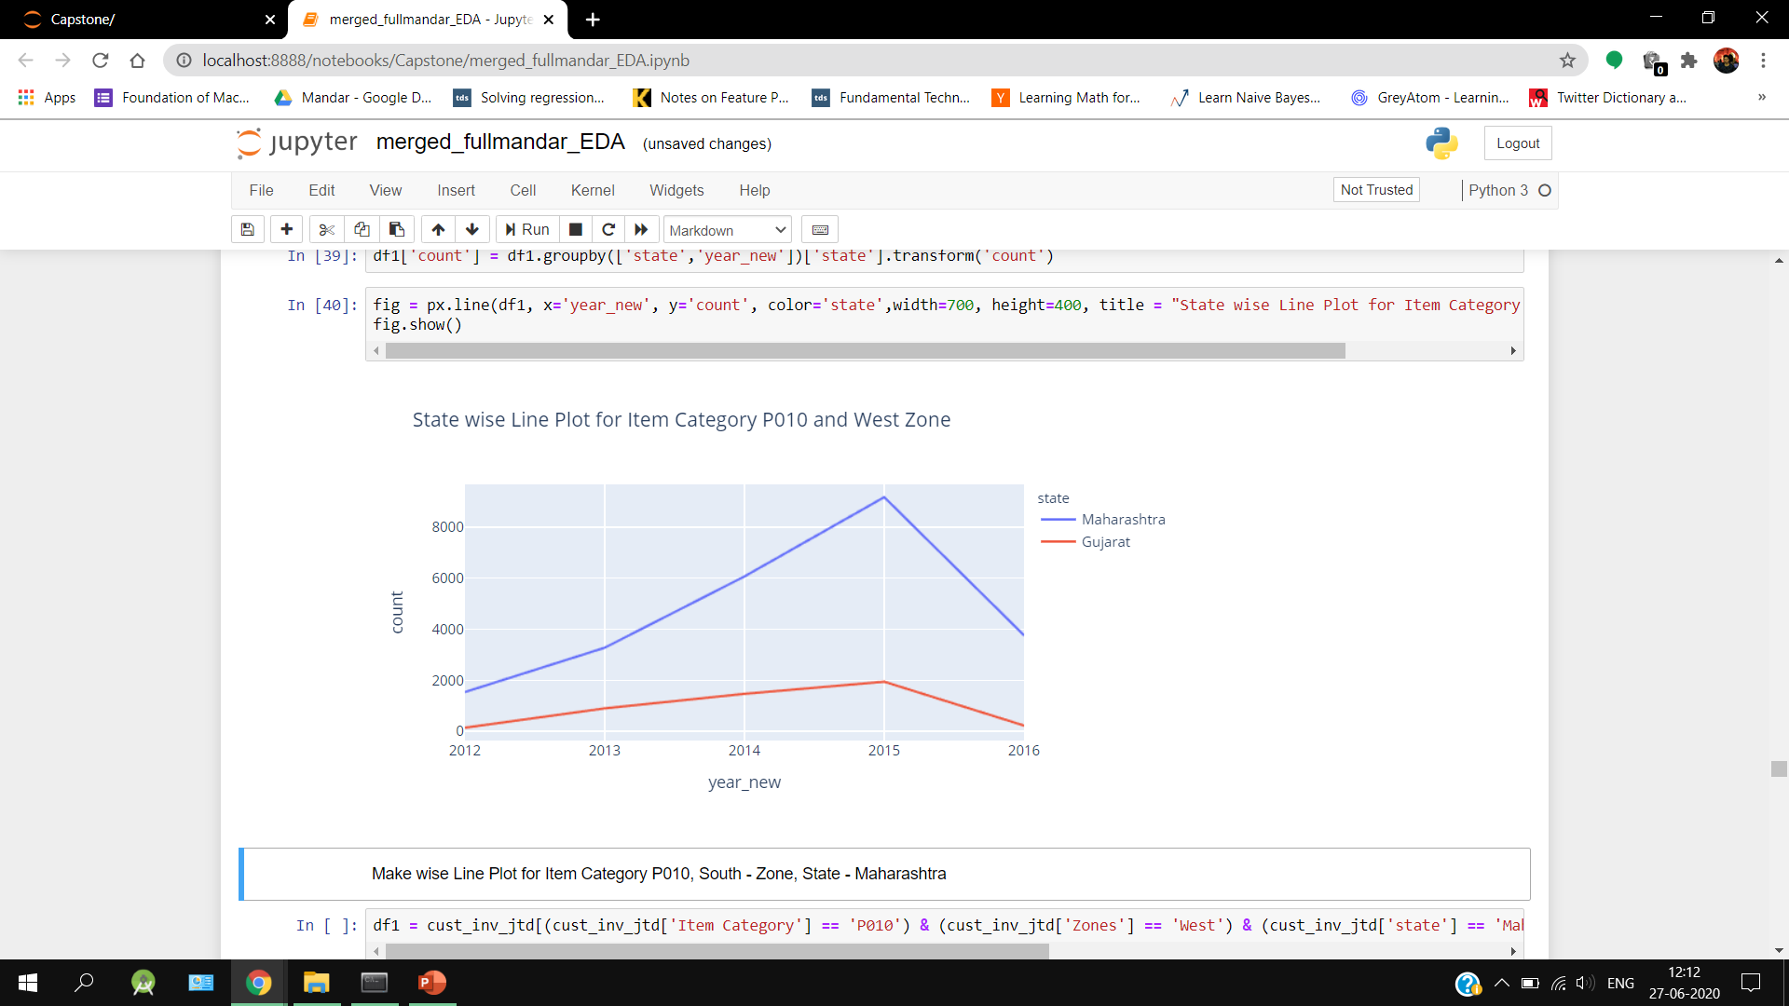
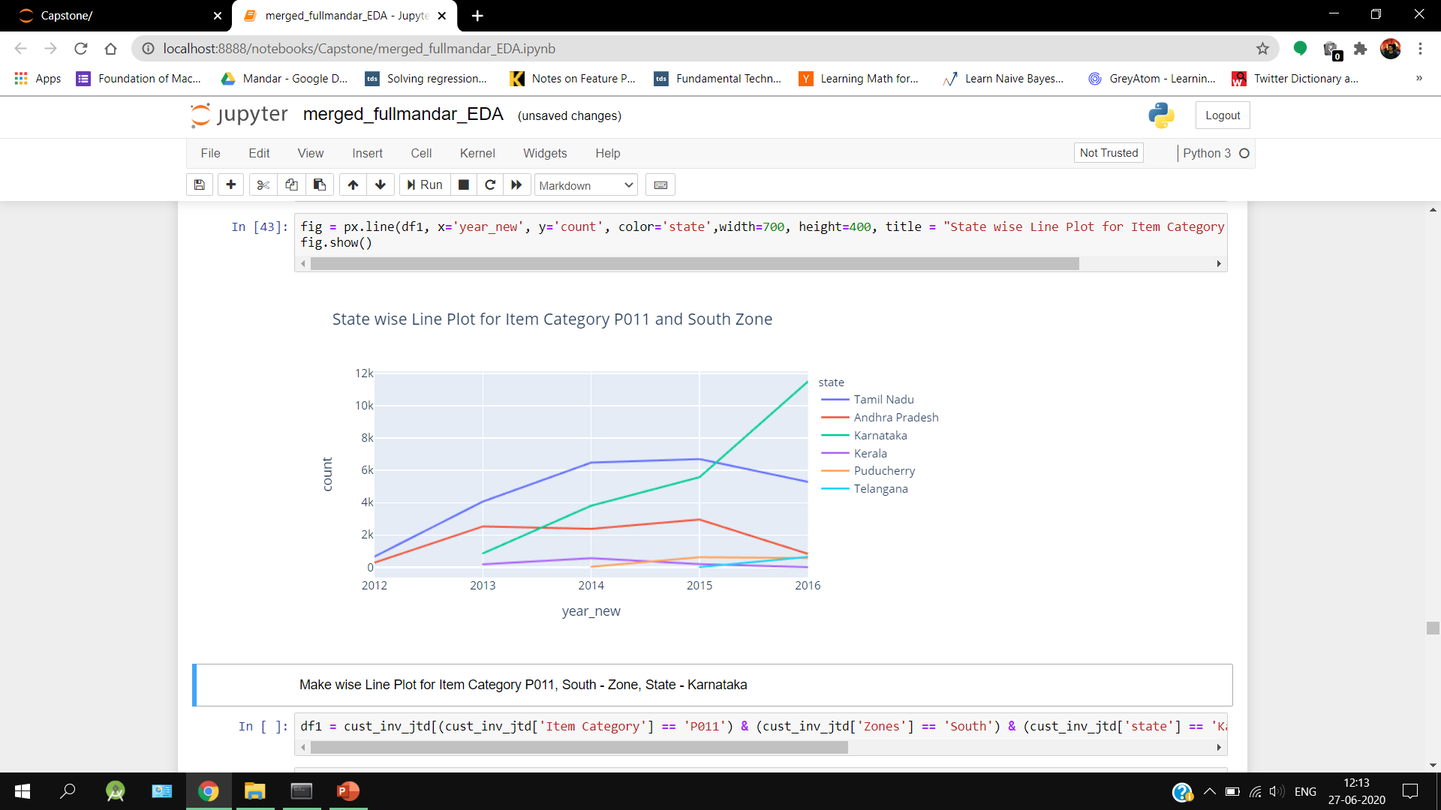
State wise Item Category count

Slide 20
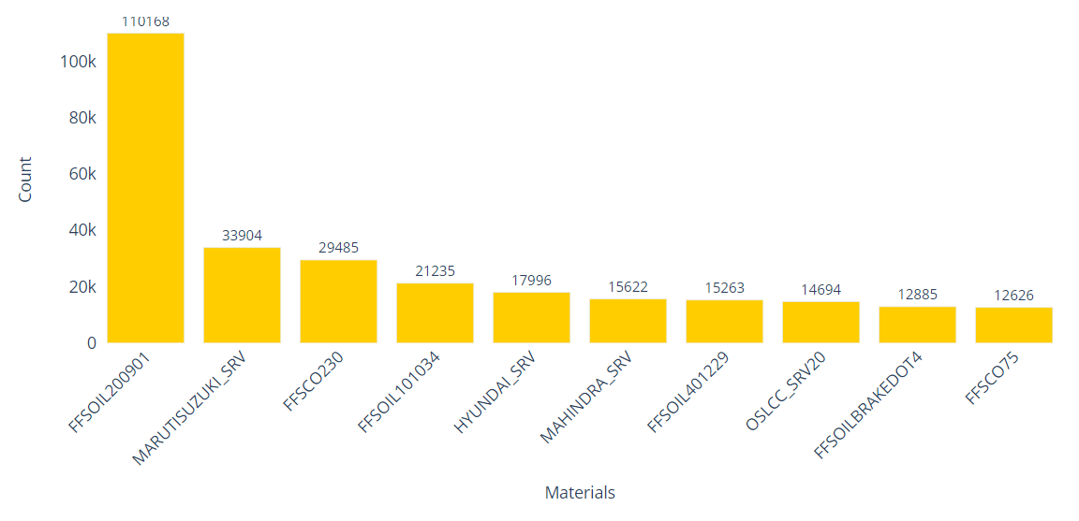
Distribution of Materials

Slide 21
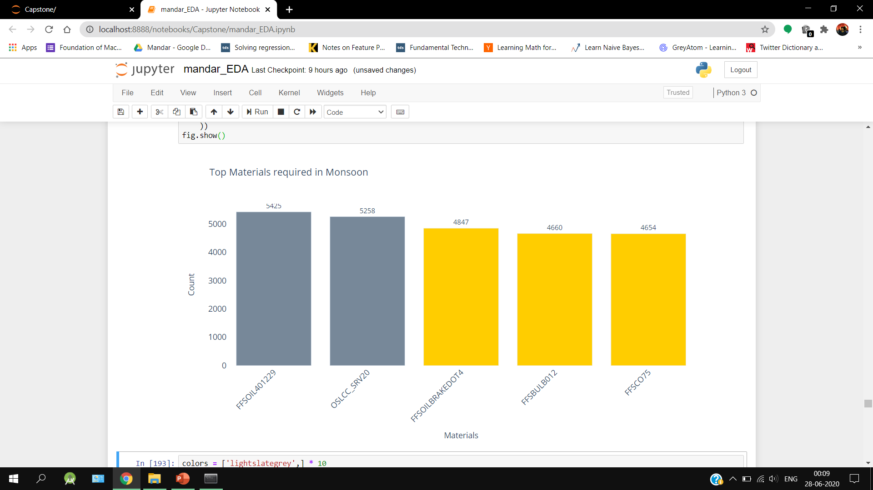
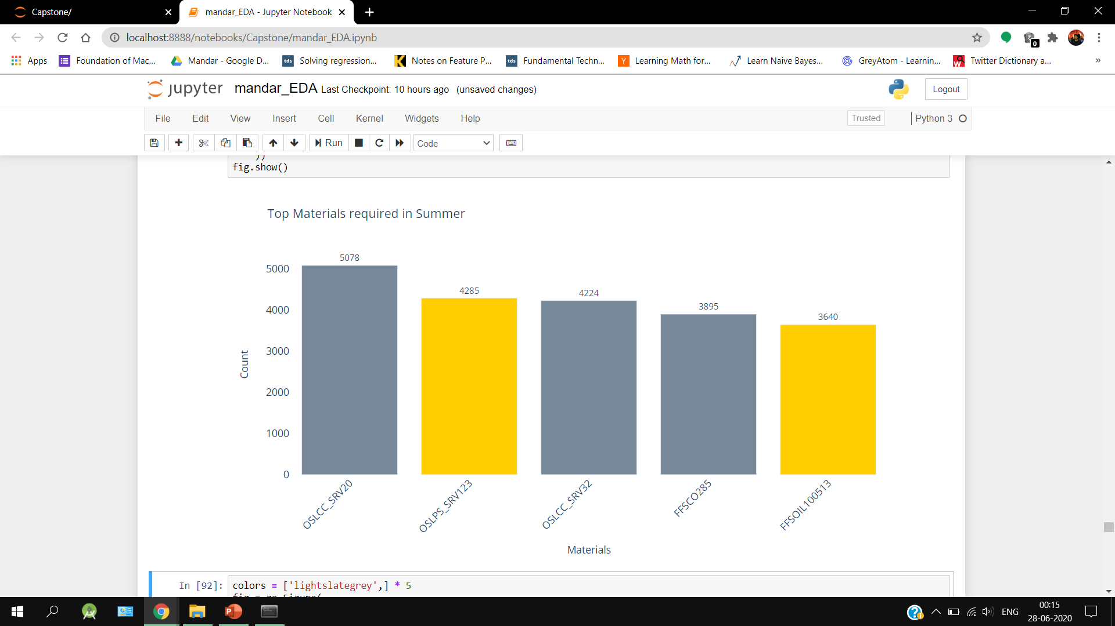
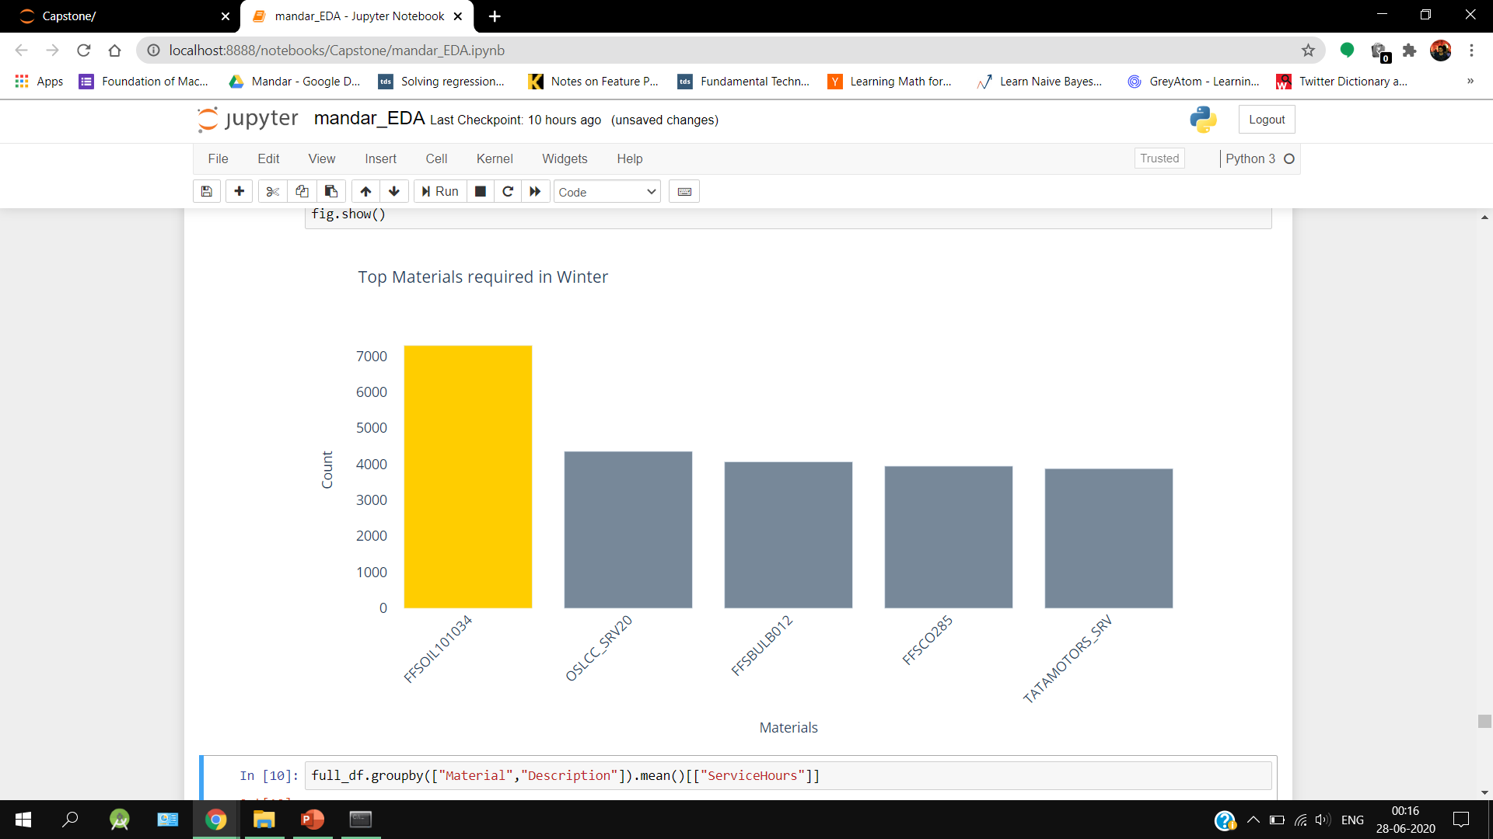
Top Materials required across Seasons

Slide 22
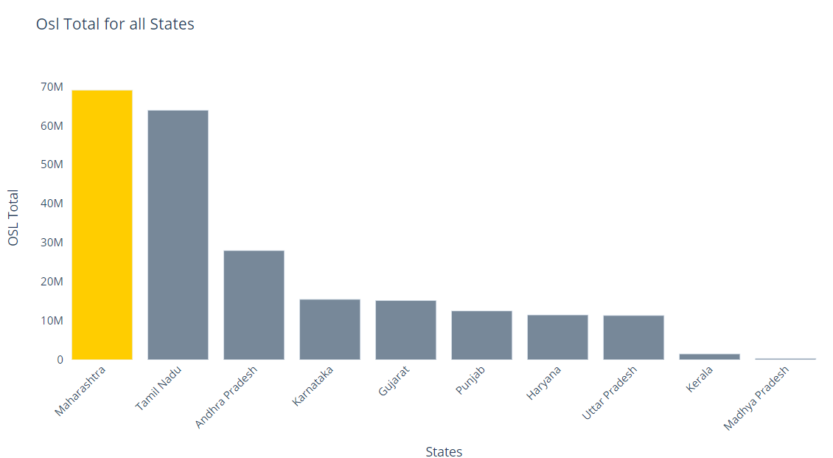
OSL Total for Top States

Slide 23
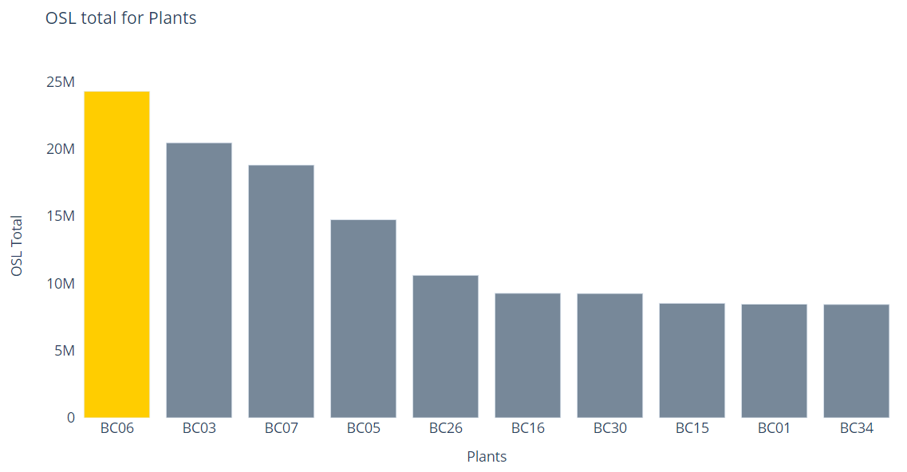
OSL Total for Top Plants

Slide 24
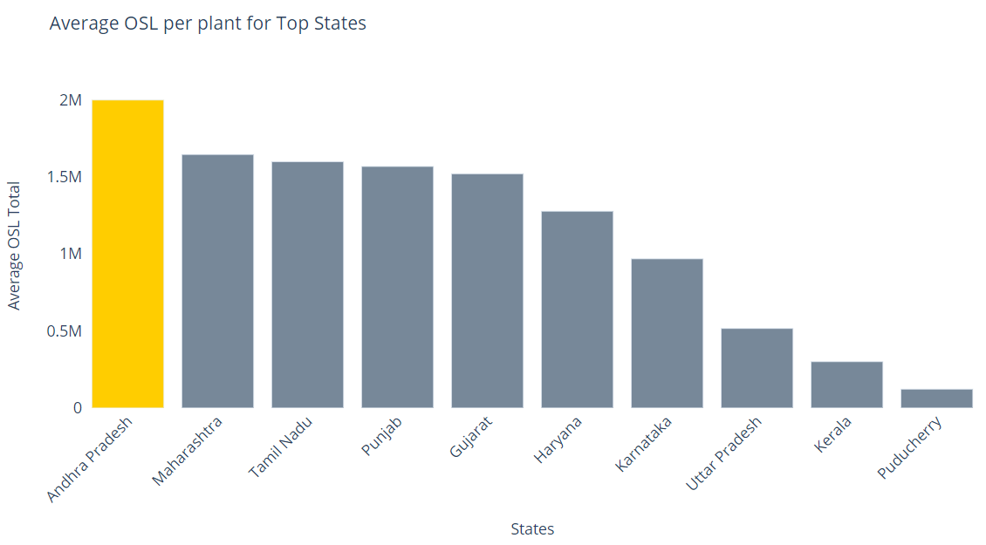
Average OSL per Plant for Top States

Slide 25
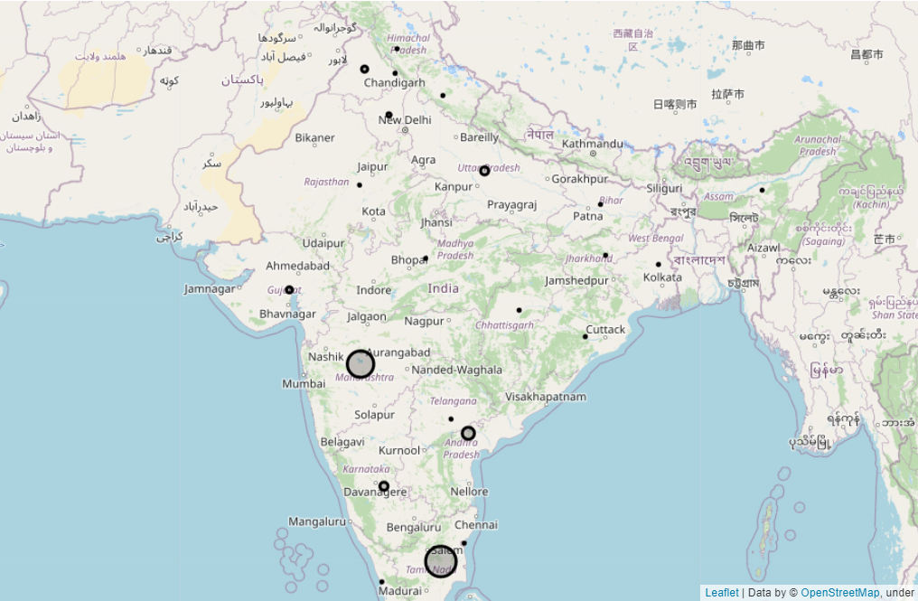
State wise revenue

Slide 26
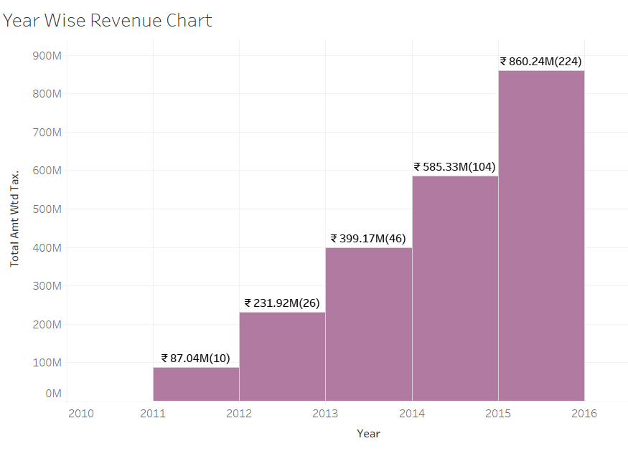
Year wise Revenue

Slide 27
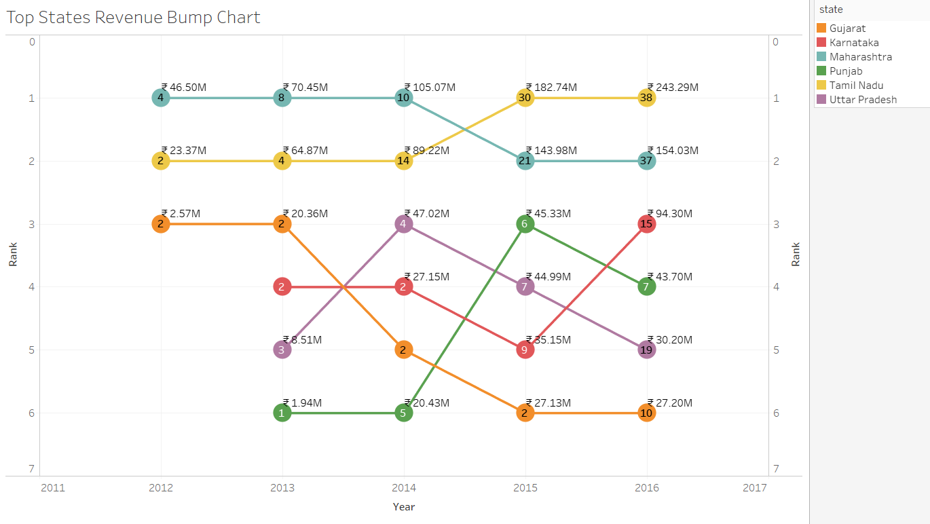
Year wise Revenue of Top States

Slide 28
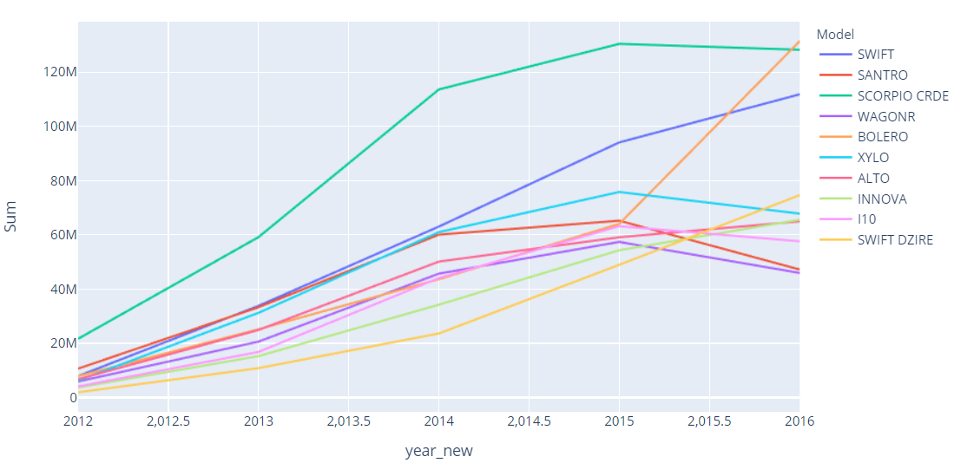
Model wise Yearly revenue

Slide 29
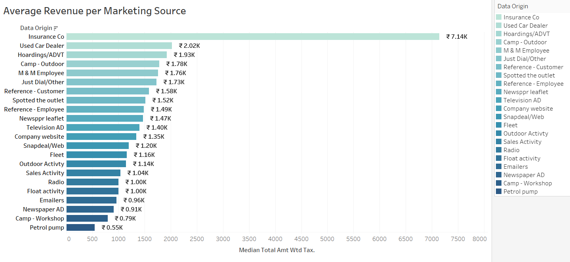
Average Revenue per Marketing Source

Slide 30
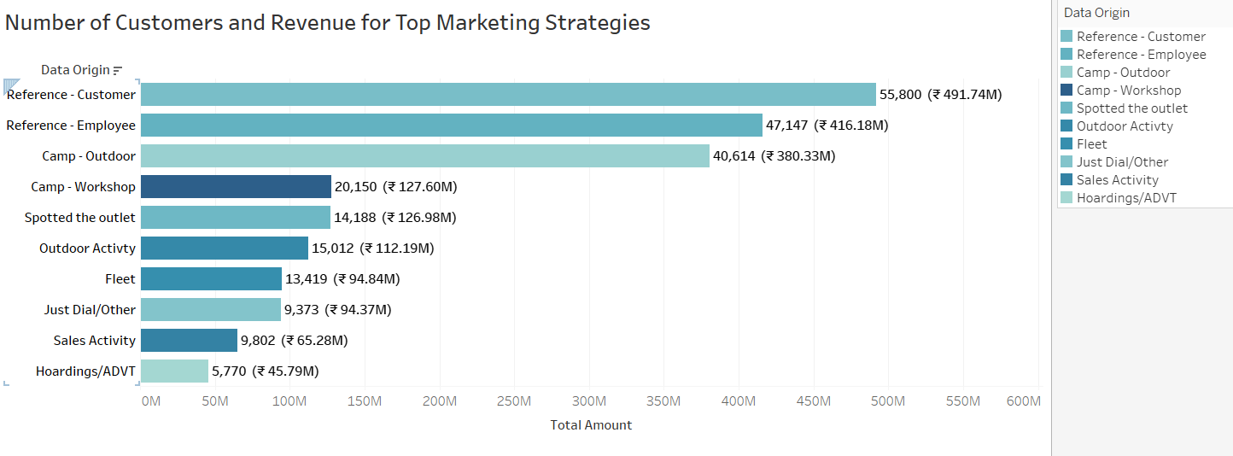
Top Marketing Sources and Total revenue

Slide 31
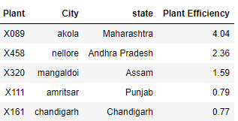
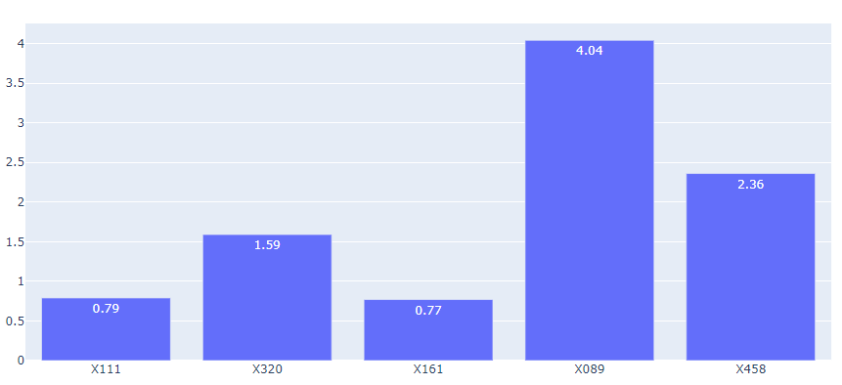
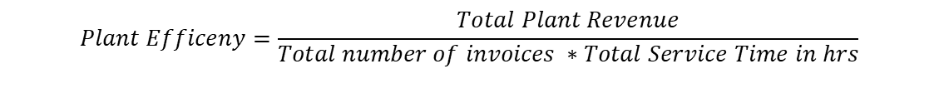
Efficiency of Top Plants
$$Plant Efficeny=\frac{Total Plant Revenue}{Total number of invoices ∗Total Service Time in hrs}$$

Slide 32
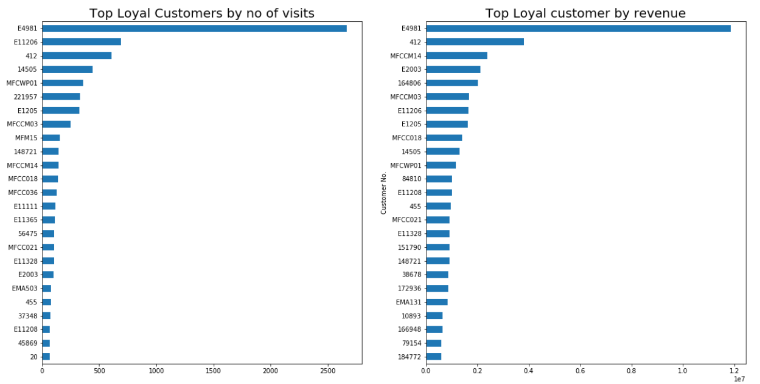
Top Loyal Customers

Slide 33
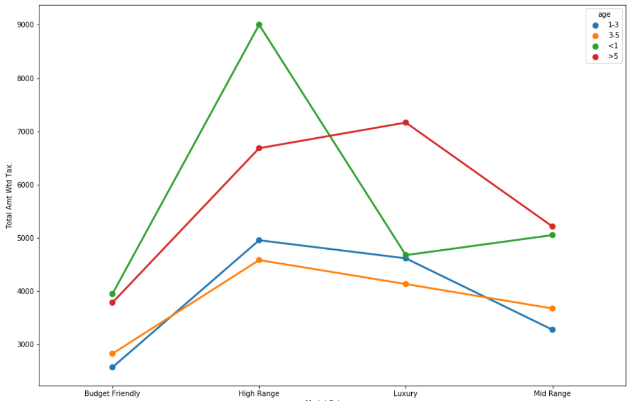
Age and Model Category wise Average amount
As seen in the graph, initial years average spending on a high range car shoots up tremendously as compared to other car types.

Slide 34
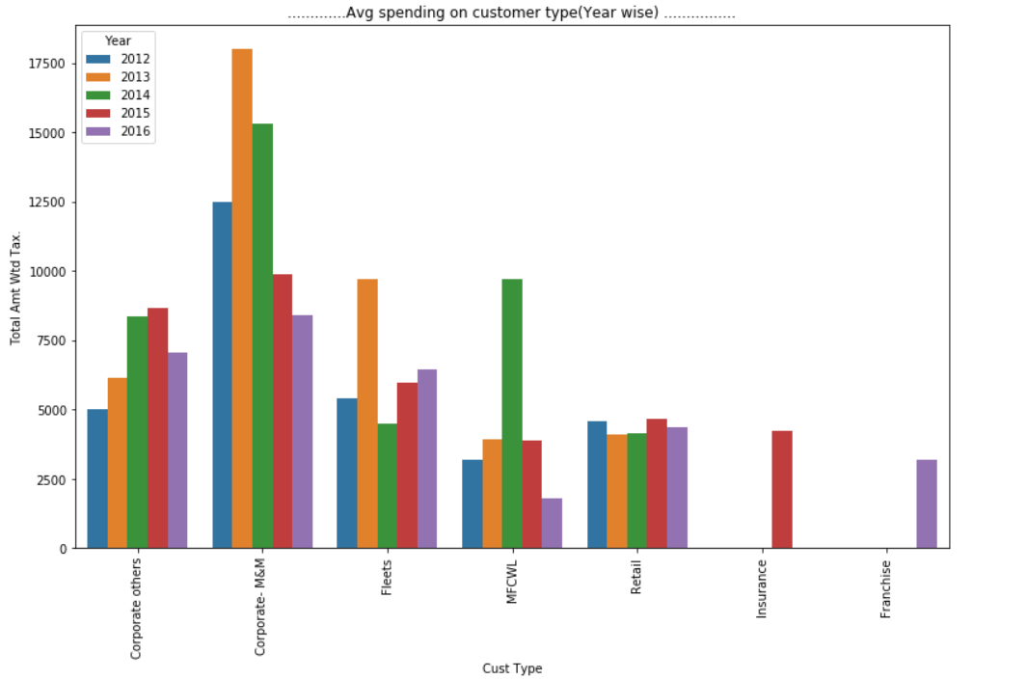
Year wise Average Spending based on Customer Type
Franchise was started in 2016.
Insurance was included in 2015 but there is no data of 2016.

Slide 35
Market Segmentation
Lets Start with clustering of data

Slide 36
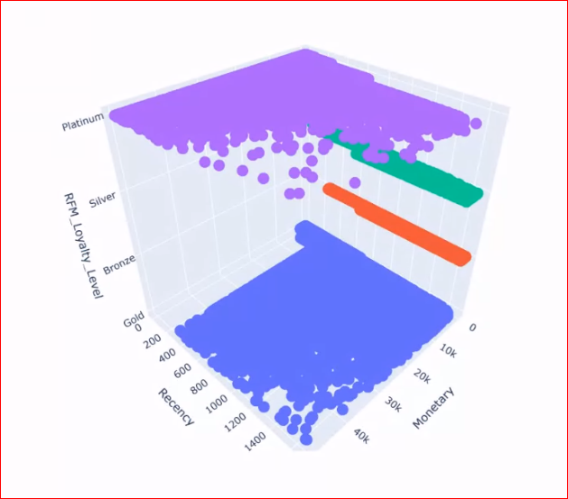
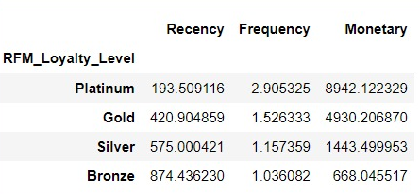
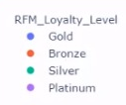
Customer Segmentation using Rule Based Clustering

Slide 37
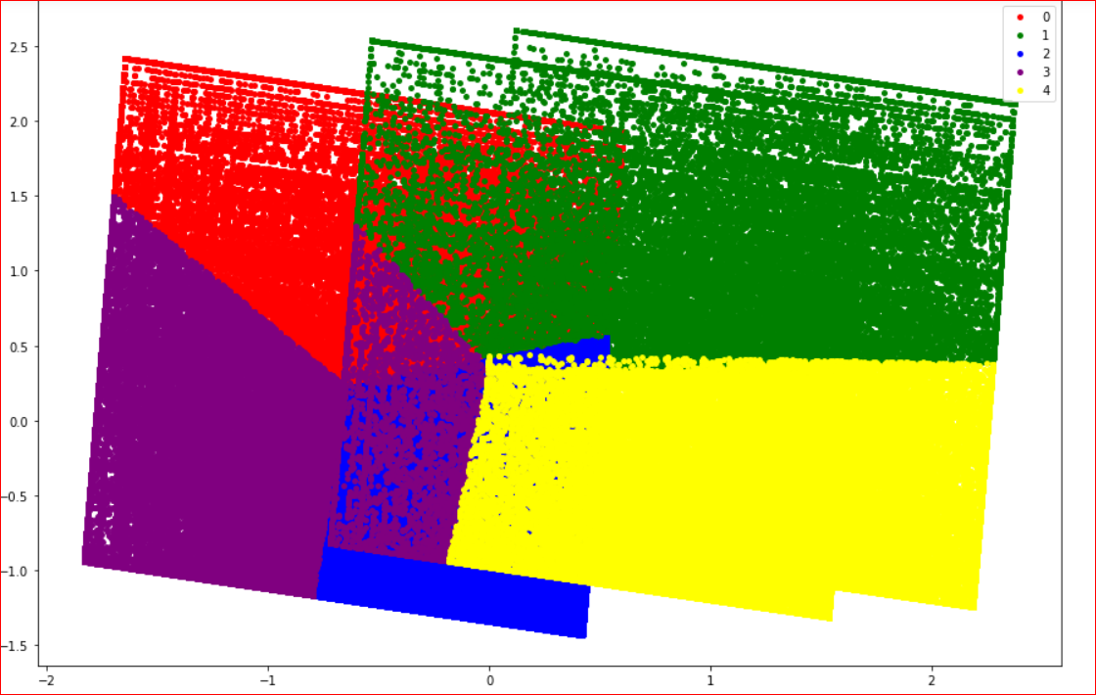
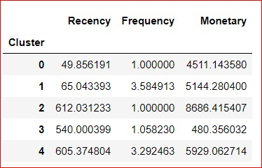
Customer Segmentation Based on RFM using Kmeans
0 - New customer with good monetary
1 - Loyal customers with good RFM
2 - Inactive customers who generated Good revenue
3 - Low RFM customers
4 - periodic customer who give good monetary

Slide 38
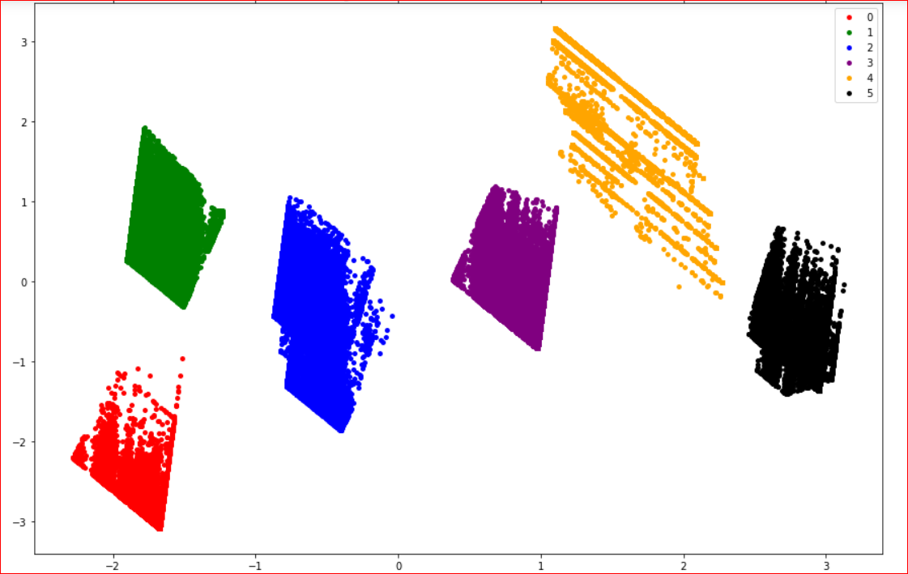
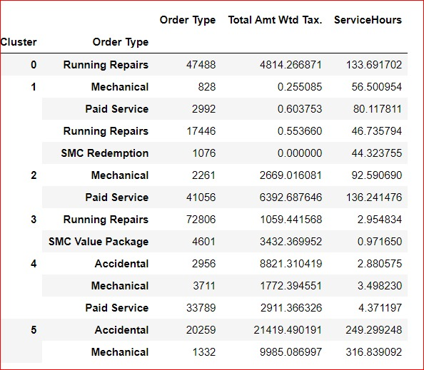
Customer Segmentation Based on Order Type, Service hours and Revenue

Slide 39
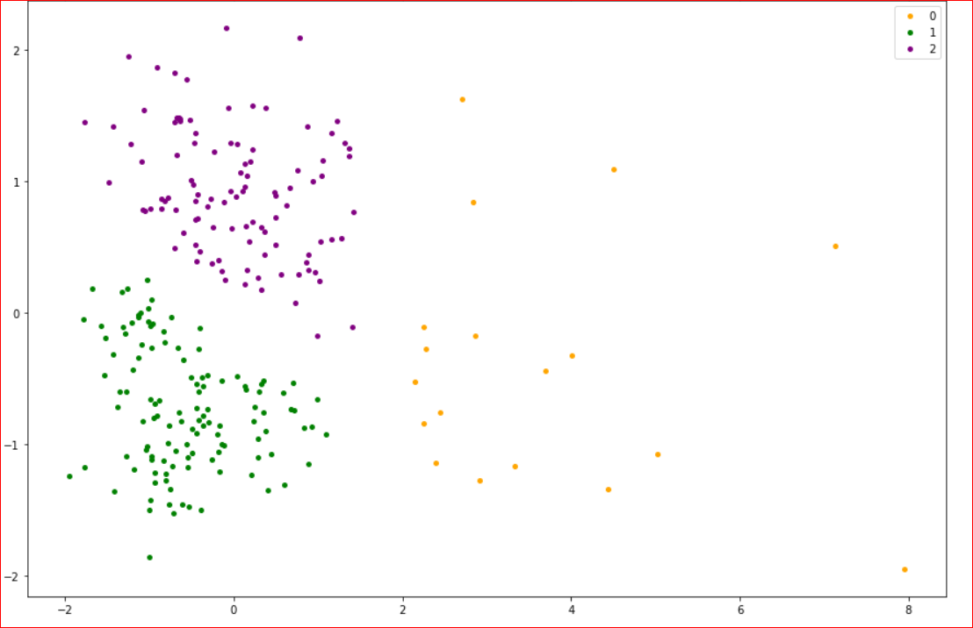

Plant Segmentation Based on Service Hour and Revenue
0-Low revenue generated and customers count
1-More efficient plant ,customer count and revenue generation are high with average service hours
2.Busiest plant but customer count is low and revenue is average

Slide 40


Technician Segmentation Based on Service Time and Laboure Cost

Slide 41


CLV Segmentation Based on Average Service Time, Frequency and Recency
0-Old customers which clv is good
1-low clv customers
2-new customer with good clv
3-Very good clv customers with good frequency

Slide 42

Data Preprocessing
Lets Start with preprocessing of data

Slide 43
Data Preprocessing
Dropped columns
Clean state and city names
Treated null values in model, data origin and Partner type column
Bucketed states in zones
Created year, month and season features
Calculated total service hours
Calculated age of the cars
Scraped car prices for bucketing models into Categories

Slide 44


Customer Lifetime Value
Lifetime value of the customer is a metric that represents the total amount of a money a customer is expected to spend over the lifetime of the car.
$CLTV=Customer Frequeny ∗Average Amount Spent$
We have calculated Customer LTV for the year 2016.

Slide 45

Modelling
Lets Start with Model Building

Slide 46
Modelling
Models | Cross Validation Score
Decision Tree Classifier | 0.911
Random Forest Classifier | 0.912
XGB Classifier | 0.912
Decision Tree Regressor | 0.976
Random Forest Regressor | 0.928
Classification Output:
Low LTV group (<2884)
Mid LTV group (2884 to 5444)
High LTV group (>5444)

Slide 47


Time Series Forecast

Slide 48
Actionable Insights
States like Karnataka ,Tamil Nadu and Madhya Pradesh had huge spike in customer base every year. Implement their marketing strategies in states with low customer count
Investigate the reasons for dip in revenue of Uttar Pradesh and Telangana
Eastern states have a significantly lower share of the revenue. This is due to low customer count from these states. More plants could be opened up in this states and marketing strategies similar to top states could help increase the customer base in eastern states.
Majority of cars visiting the workshop are of these 4 brands – Maruti Suzuki, Hyundai, M&M and Tata Motors. Inventory should be stocked up accordingly.
Though invoice of Accidental cases are less, they contribute the largest share to the revenue. Average service time is also the highest. To reduce the same, spare parts of top brands stated above could be stocked up in advance.
The top marketing source has been Customer Reference. We could arrange rewards programs for customers sharing positive testimonials to increase the customer base.

Slide 49

Thanks!

